Slide 1
Basic principles of flow cytometry
02/24/26

Slide 2
How to avoid artifacts in flow cytometry
Reagent titration: how to achieve the best separation over background
Multicolor (>1 parameter) compensation
Spreading error in multicolor FACS
Presentation of high-quality data for publication

Slide 3
How to avoid artifacts in flow cytometry
Reagent titration: how to achieve the best separation over background
Multicolor (>1 parameter) compensation
Spreading error in multicolor FACS
Presentation of high-quality data for publication

Slide 4
Pro and cons of antibody titration
PRO
Can save a lot of money (100 tests can become 400, or more)
Better separation, less background
VERY important when performing multicolor analysis (can minimize ‘spreading’ in other channels)
CONS
None

Slide 5
Abs: not just the manufacturer’s instructions
Fresh PBMC stained with 7 two-fold serial dilutions of BV421 anti-CD14 (µL of Ab in 100 µL total volume for 20’ at RT)
Titer:

Slide 6
Abs: not just the manufacturer’s instructions
0.07
0.15
0.3
0.6
1.25
2.5
5
Titer
AIM: Choose the titer at which the best separation between the positive and the negative
is achieved without increase in the background

Slide 7
Abs: not just the manufacturer’s instructions
✓
SNR: Signal-to-noise ratio
MFI: median fluorescence intensity
SNR: MFI (pos) / MFI (neg)
✓
SNR
0.07
0.15
0.3
0.6
1.25
2.5
5
Titer
Titer
AIM: Choose the titer at which the best separation between the positive and the negative
is achieved without increase in the background

Slide 8
Abs: not just the manufacturer’s instructions
Titer
Saturating titer: titer at which all receptors are saturated
(no increase in positive signal despite the increase of the Ab concentration)
Separating titer: titer at which separation between the positive and the negative is obtained

Slide 9
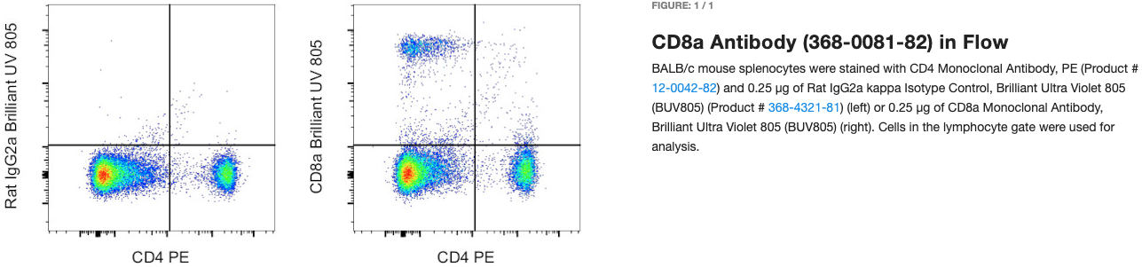
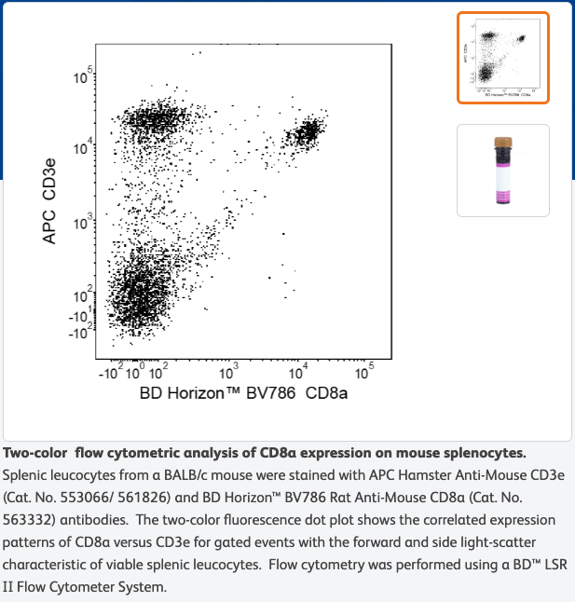
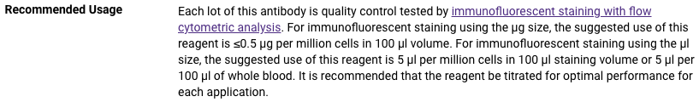
What they say you can use…
CD8α BV786 (53-6.7)
Thermo Fisher
BD
0.25 µg!
1.25 µL or 1:80
BioLegend
0.5 µg!
2.5 µL or 1:40
??? µg!

Slide 10
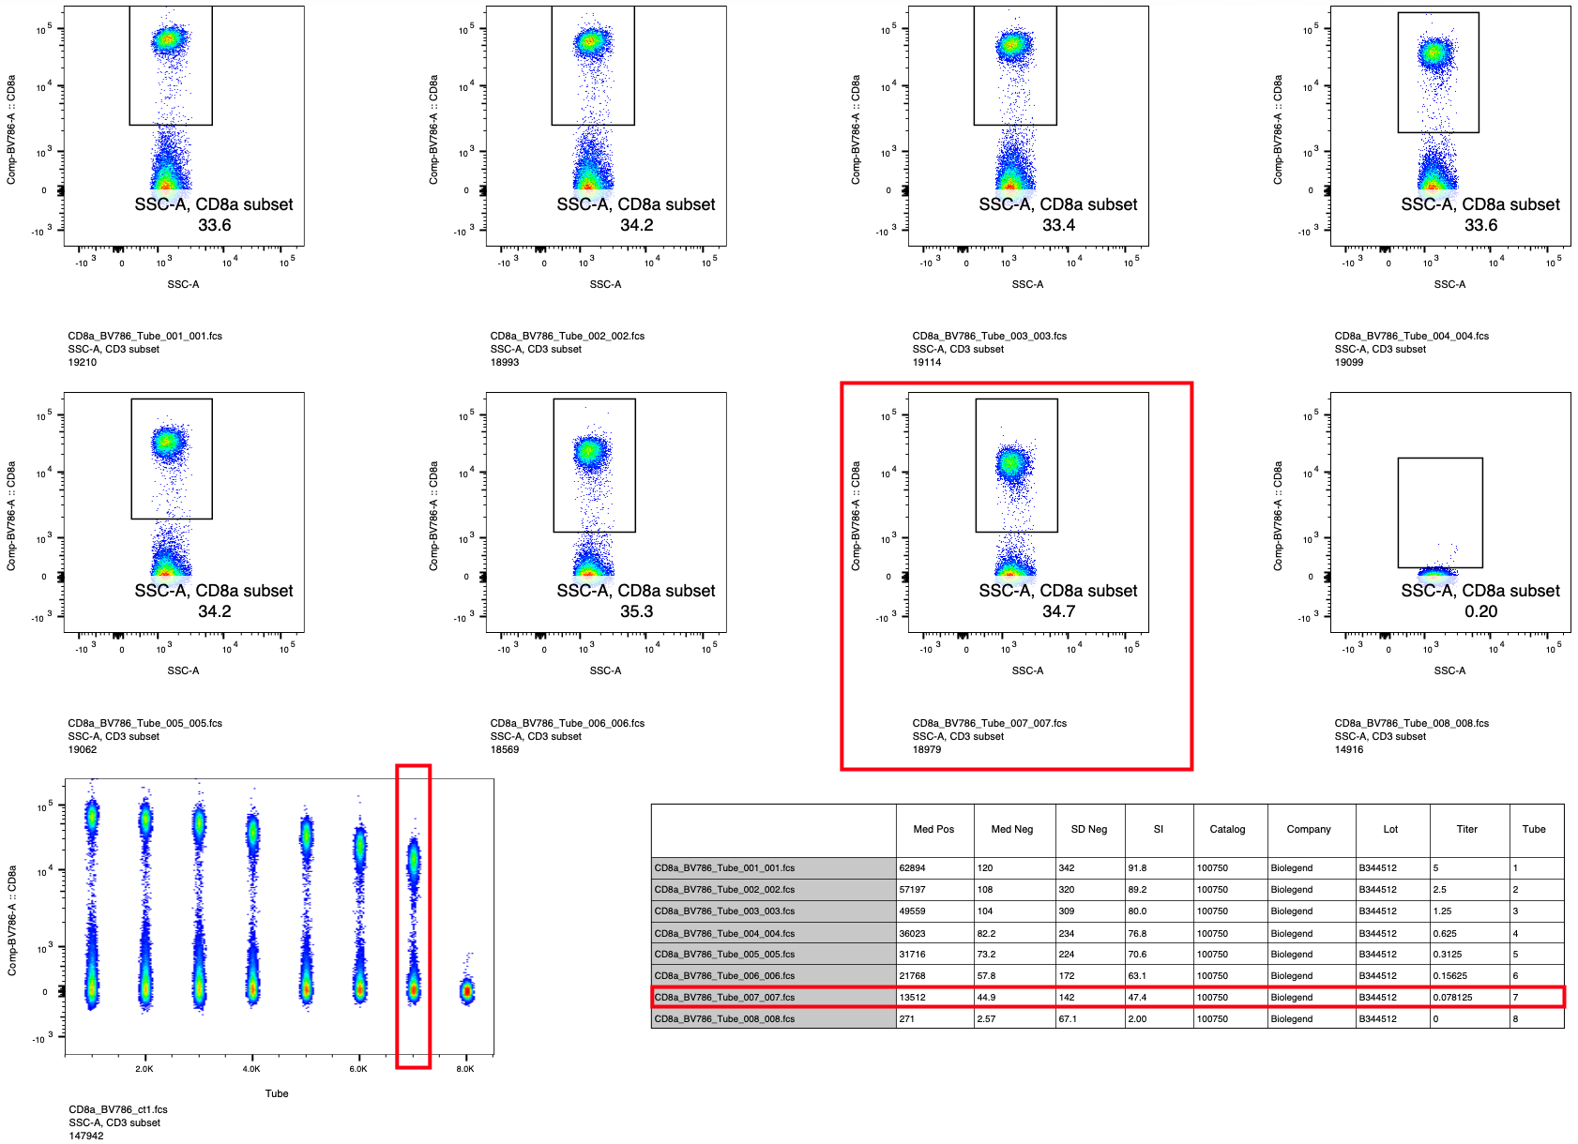
What you can actually use…
0.016 µg!
0.078 µL or 1:1,250

Slide 11
Critical parameters affecting titers
TIME: the longer the incubation the lower the titer needed to reach saturation
TEMPERATURE: some Abs stain better at certain temperatures, e.g. chemokine receptors give a much higher fluorescence when stained at 37°C compared to RT or 4°C
BUFFER: intracellular staining (Fix/Perm buffers) can alter the optimized titer → titrate antibodies with the buffer used in the staining
Cell number DOES NOT affect the Ab titer. The Ab is always in vast excess to the number of molecules, unless cell number changes dramatically.
General rule: the optimized titer can be used to stain up to 10-15x10⁶ cells in 100 µL total volume.

Slide 12
How to avoid artifacts in flow cytometry
Reagent titration: how to achieve the best separation over background
Multicolor (>1 parameter) compensation
Spreading error in multicolor FACS
Presentation of high-quality data for publication

Slide 13
Compensation practices
Compensation can be performed manually (at the machine) or automatically (via software)
Manual compensation: tedious, need to check carefully that positive and negative signals have to match
Automated compensation: no errors, if using the right controls
Manual compensation is impractical in a multicolor experiment (roughly 2^{n} pairwise combinations)
Changing compensation in a pairwise combination affects distribution in other channels

Slide 14
What are the right controls?
The 3 golden rules of compensation
Use a single-stained control that is at least as bright as the test staining
Use the same reagent that is being used in the staining (valid for tandems such as PE-Cy7, APC-Cy7, etc. – for non tandems any reagent is OK)
Have a paired-negative control with the same autofluorescence as the positive (cells with cells, beads with beads, etc.)
Everything else is not necessary!

Slide 15
Rule #1: at least as bright!
Overcompensation of FITC into Alx594
Comp control is not as bright as the test stain
Alexa 594 CCR7
FITC IFNγ
Comp control
Test staining: IFNγ

Slide 16
Rule #2: same reagent for tandems!
Wrong
Correct
Wrong comp
13.2% subtraction
PE
Correct comp
3.4% subtraction
PE
Negative control
PE-Cy5.5
PE-Cy5.5
Compensation requirements can be different from lot to lot of the same Ab

Slide 17
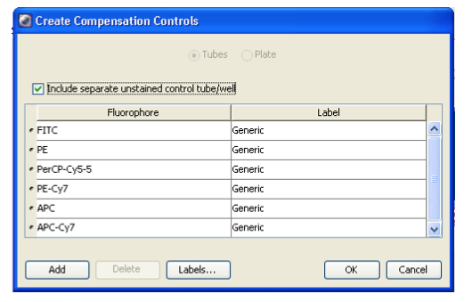
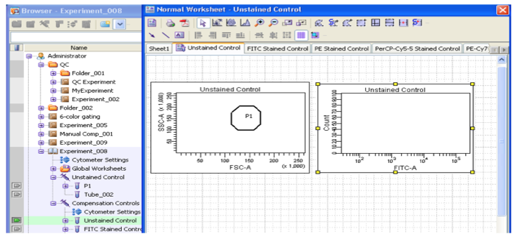
How to compensate in FACSDiva
Choose Experiment → Compensation setup → Create compensation controls
Run single-stained controls, including negative
Select positive and negative signal from each control
For comp tubes containing both positive and negative,
draw an additional gate to select the negative population
Choose Experiment → Compensation Setup → Calculate Compensation.
Enter a compensation setup name, click Link and Save, and click OK.

Slide 18
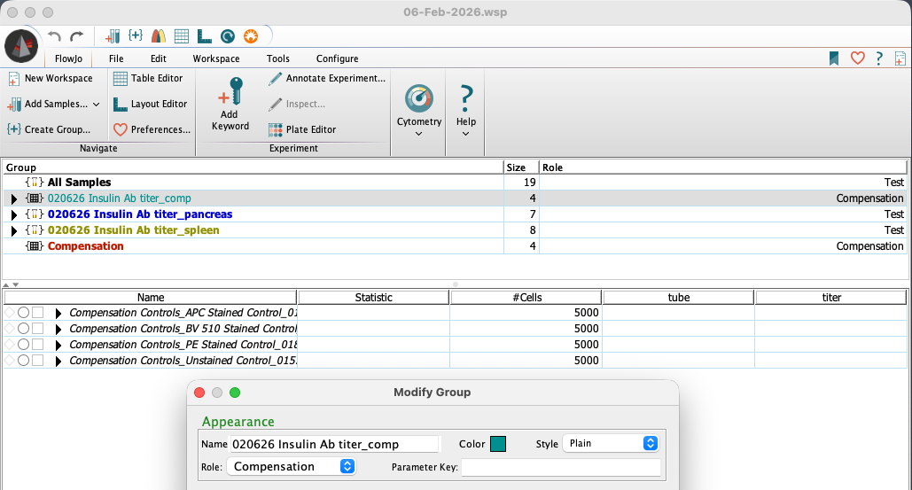
How to compensate in FlowJo
Saves time at the instrument!
Create compensation controls as explained in the slide before
Import all files to FlowJo
3
1
2

Slide 19
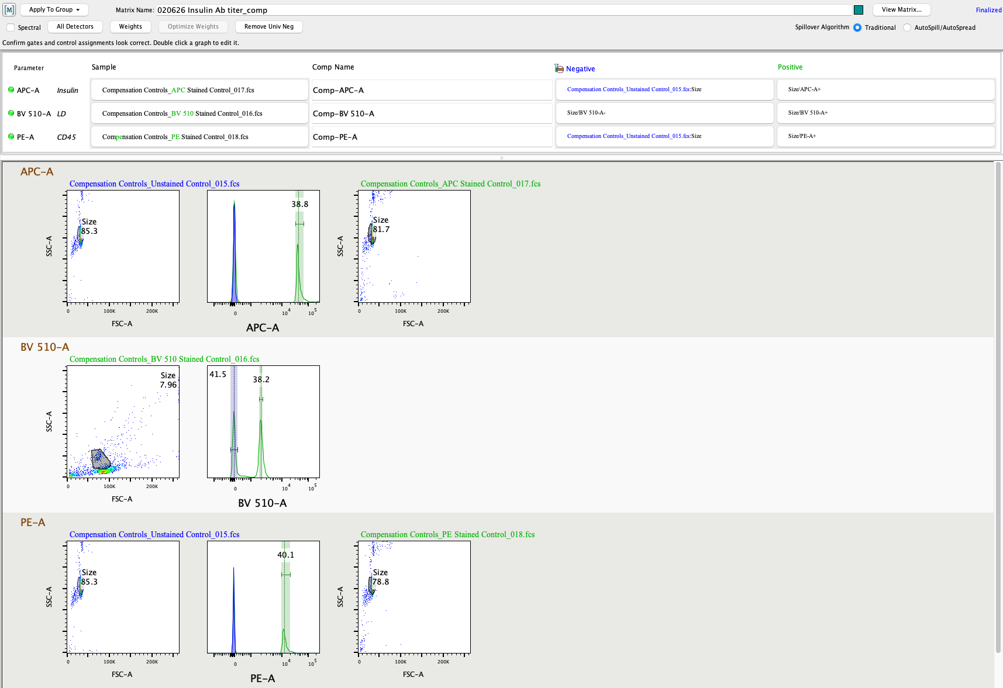
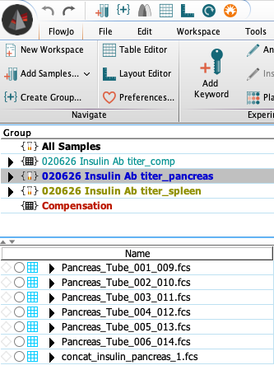
How to compensate in FlowJo
6
4
5
7

Slide 20
Changing compensation affects distribution in other channels
8
FITC (em. 525) and PerCP
(em. 670) are distant enough
Possibly wrong comp between PerCP
(em. 670) and PE-TxR (em. 610)
9
START FROM SPLEEN (easy, standard, familiar)
THEN CHECK ALL TISSUES! And always keep your eyes open for artifacts

Slide 21
How to avoid artifacts in flow cytometry
Reagent titration: how to achieve the best separation over background
Multicolor (>1 parameter) compensation
Spreading error in multicolor FACS
Presentation of high-quality data for publication

Slide 22
‘Errors’ in compensation
Properly compensated data may not appear rectilinear because of measurement errors (are more prominent in case of limited numbers of photons, like PE-Cy7 or APC-Cy7 dyes, with low energy)
Measurement errors are directly proportional to the intensity (LOG relationship)
This effect on compensated data is unavoidable, and cannot be corrected with compensation (LINEAR correction)
Compensation does not introduce the error, it only reveals it because it brings the distribution to the low end of the log scale

Slide 23
Signal spreading
Compensated with transformation
Uncompensated
Compensated
2000
+500
1000
-500
What causes this spread? Photon counting statistics introduces a measurement error

Slide 24
How do we overcome this problem?
Use different gates: cells positive in the primary detector will have a different threshold of positivity compared to negative cells
Not a problem if analyzing bright antigens in the secondary detector
Loss of sensitivity if dim antigen in the secondary detector. Decrease titer of spreading Ab to minimize spreading.
-> Try a different Ab combination
Alexa 700
APC

Slide 25
How do we overcome this problem?
Use different gates: cells positive in the primary detector will have a different threshold of positivity compared to negative cells
Not a problem if analyzing bright antigens in the secondary detector
Loss of sensitivity if dim antigen in the secondary detector. Decrease titer of spreading Ab to minimize spreading.
-> Try a different Ab combination
100% detected
Alexa 700
APC

Slide 26
How do we overcome this problem?
Use different gates: cells positive in the primary detector will have a different threshold of positivity compared to negative cells
Not a problem if analyzing bright antigens in the secondary detector
Loss of sensitivity if dim antigen in the secondary detector. Decrease titer of spreading Ab to minimize spreading.
-> Try a different Ab combination
100%
detected
~50%
detected
Alexa 700
APC

Slide 27
Fluorochrome relative brightness chart
Relative brightness

Slide 28
How to avoid artifacts in flow cytometry
Reagent titration: how to achieve the best separation over background
Multicolor (>1 parameter) compensation
Spreading error in multicolor FACS
Presentation of high-quality data for publication

Slide 29
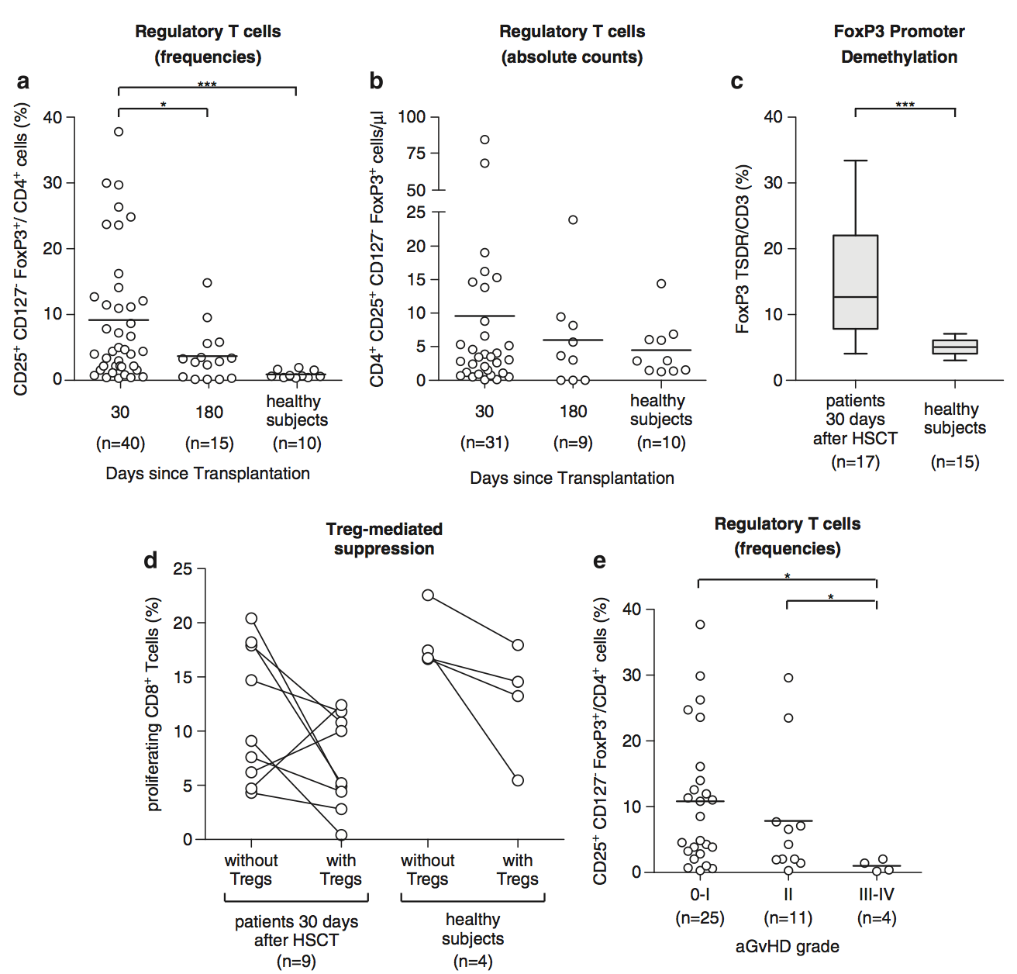
Some papers rely heavily on FACS

Slide 30
Some papers rely heavily on FACS
WHERE ARE THE DATA?

Slide 31
Questions
Were the data compensated correctly?
And the gating? Same gates used for all patients/controls?
Were antibodies titrated?
How many events were acquired?
Cannot tell if raw data are not provided

Slide 32
Careful with histograms
Histograms are very intuitive but display only one parameter
(we now live in a multicolor world)
88.1
Under
compensated
CD4
77.8
Correctly
compensated
CCR7
CCR7

Slide 33
Dot vs. density plot vs. contour
Multiple ways to display data – use depends on applications
Color
Contour
CCR7
Density
Dot
CD45RA

Slide 34
Dots are useful with low numbers
High resolution
(can’t see anything)
Low resolution
(better, but gates?)
CCR7
No idea of number of events
CD45RA

Slide 35
Dots are useful with low numbers
Total CD8+
Ag-specific
Dots overlaid on density plot
Contrasting colors
Total CD8+ cells allow to see population distribution

Slide 36
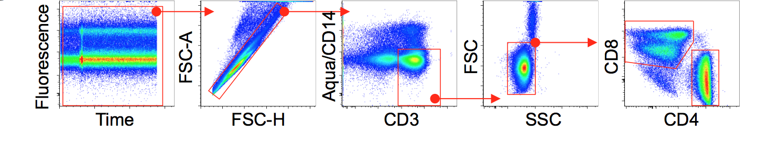
CD8 gating strategy
Is fluorescence stable over time?
Spreading of CD8 into CD4: optimal gate?
Dead cells excluded correctly? Contaminating populations such as Monos?
Doublets excluded?
Only small lymphocytes or also large lymphocytes included?

Slide 37
How to avoid artifacts in flow cytometry
Reagent titration: how to achieve the best separation over background
Multicolor (>1 parameter) compensation
Spreading error in multicolor FACS
Presentation of high-quality data for publication

Slide 38
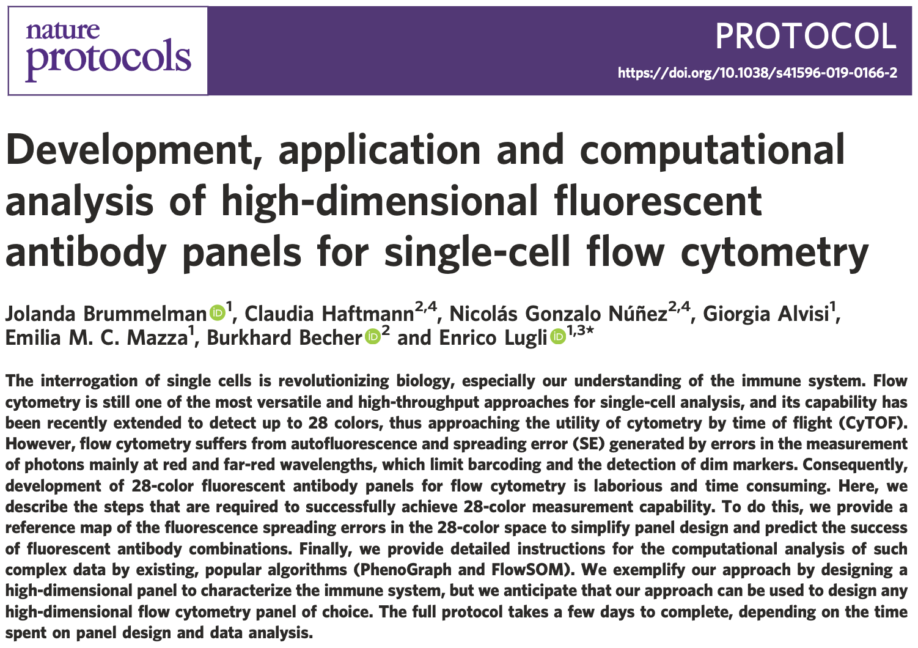
Suggested read
https://www.nature.com/articles/s41596-019-0166-2

